Slide 1
评估立体定向体外放射治疗局部晚期和临界可切除胰腺癌的疗效
刘适
齐齐哈尔医学院附属第三医院

Slide 2
Introduction
胰腺癌是最具侵袭性的癌症之一，其5年生存率为6%，中位生存期为13.6个月；
局部晚期胰腺癌和临界可切除胰腺癌患者的治疗在很大程度上是无效的和有争议的；
联合放化疗或综合化疗是常见的选择。尽管如此，这些治疗往往伴随着严重的毒性反应（等级≥3）；
立体定向体外放射治疗 (SBRT) 已被用于非小细胞肺癌、前列腺癌、肝癌和胰腺癌等实体瘤的治疗。

Slide 3
Introduction
SBRT只需几个疗程就能向肿瘤提供较高剂量的辐射。
与传统的放疗相比，放射疗程更少的SBRT可以更方便地与化疗联合应用。
这种说法是有争议的 (由于剂量测定的准确性和对正常组织的保护，与传统放疗相比SBRT显示出卓越的治疗效果并且急性和晚期毒性更小。)

Slide 4
Introduction
许多关于SBRT治疗胰腺癌的研究已经发表，基于荟萃分析的各种生存结果数据已被报道，特别是在过去的5年；
Buwenge等人着重研究了SBRT缓解胰腺癌疼痛的效果；
Zaorsky等人报道了SBRT剂量与胰腺癌治疗效果之间的关系；
Petrelli等人基于2016年以前的数据对SBRT治疗胰腺癌进行了回顾。

Slide 5
Introduction
这启发了我们进行了这一系统的回顾和荟萃分析;
旨在整合最新和最完整的关于SBRT治疗局部晚期胰腺癌和临界可切除胰腺癌后的生存结果和毒副作用；
我们期望这些信息将有助于评估SBRT治疗局部晚期胰腺癌和临界可切除胰腺癌的疗效和安全性。

Slide 6
Search strategy
PubMed, EMBASE, Cochrane Library, SCOPUS and Web of Science
(pancreatic OR pancreas) AND (cancer OR carcinoma OR adenocarcinoma OR neoplasm) AND (SBRT OR stereotactic body radiotherapy OR stereotactic body radiation therapy OR stereotactic body radiotherapy OR stereotactic radiosurgery OR radiosurgery)

Slide 7
Study selection
Published in english;
Reported LAPC or BRPC or unresectable pancreatic cancer patients treated with SBRT and SBRT as a part of the initial treatment plan;
Prospective or retrospective studies or clinical trials including at least 10 PC patients;
Reported OS or PFS data.

Slide 8
Study exclusion
Involved metastatic or re-irradiation cases;
With populations selected from the national database;
Studies with patients selected for being non-progressors;
Studies with patients treated with elective nodal irradiation and without motion management.

Slide 9
Study exclusion
Phase I trials, mechanistic researches, cell experiments, animal studies, reviews, letters, commentaries, conference abstracts, book chapters and duplicated articles.

Slide 10
Data extraction
Last name of the first author
Publication year
Study design
Study country
Age and sex of patients
Study period

Slide 11
Data extraction
The number of patients
Disease stage
Lymph node stage
Follow-up period
SBRT dose

Slide 12
Data extraction
Number of SBRT fractions
Chemotherapy regimens
Endpoints of interest
Median OS
OS (1, 2 and 3-year)
Median PFS
PFS (1, 2 and 3-year)

Slide 13
Data extraction
Incidence of grade 3–5 toxicities (acute GI,
acute hematologic, late GI and late hematologic toxicities).
When numerical data of OS and PFS was not reported, they were extracted from
the Kaplan-Meier (K-M) curves using Engauge Digitizer V12.1.

Slide 14
Quality assessment
Two independent authors used the Newcastle-Ottawa scale (NOS) to
evaluate the quality of selected studies.
High quality reports scored 7 to 9 and medium quality studies scored 4 to 6 points.

Slide 15
Statistical analysis
Median OS, OS (1, 2 and 3-year), median PFS, PFS (1, 2 and 3-year) and incidence of grade 3–5 toxicities (acute and late) were the endpoints of interest in this meta-analysis.
These endpoint proportions were pooled and analyzed using the ‘metaprop’ function in R (both fixed and random effect methods).

Slide 16
Statistical analysis
The heterogeneity among the studies was
evaluated by the I² value. I²>50% was considered an existing heterogeneity (I2>75% considered significant heterogeneity) and a random effect result was utilized, with an otherwise fixed-effect result.
Potential reasons for heterogeneity were investigated by subgroup analysis.

Slide 17
Statistical analysis
Meta-regression and sensitivity analysis.
For the subgroup analysis, studies were categorized into subgroups according to Publication year, study design, patient race and study country.
Variables of patient age, numbers of patients, follow-up period and SBRT dose were employed in the meta-regression analysis.

Slide 18
Statistical analysis
The result of each analysis was demonstrated in a forest plot.
Publication biases were assessed using funnel plots and an Egger’s test.
All statistical analyses were conducted with R using ‘meta’ package.

Slide 19
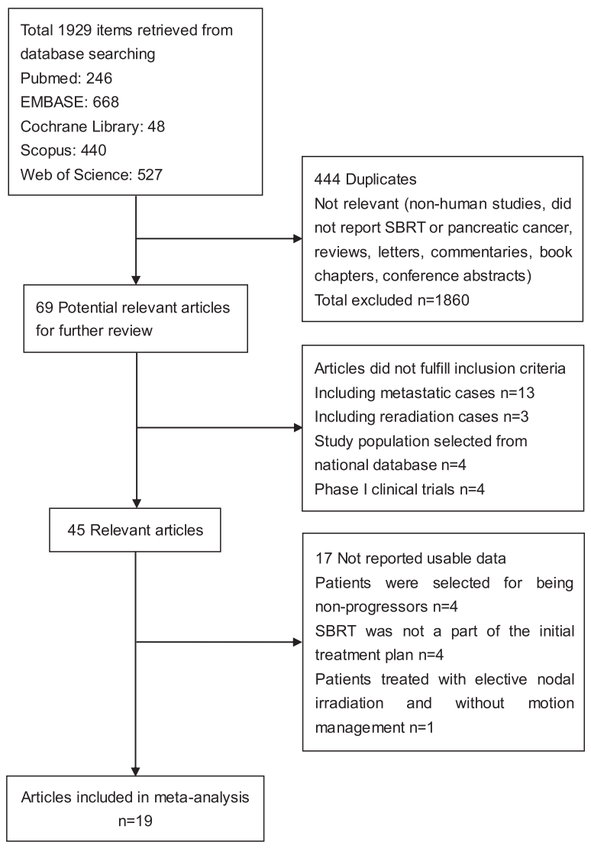
Search results

Slide 20
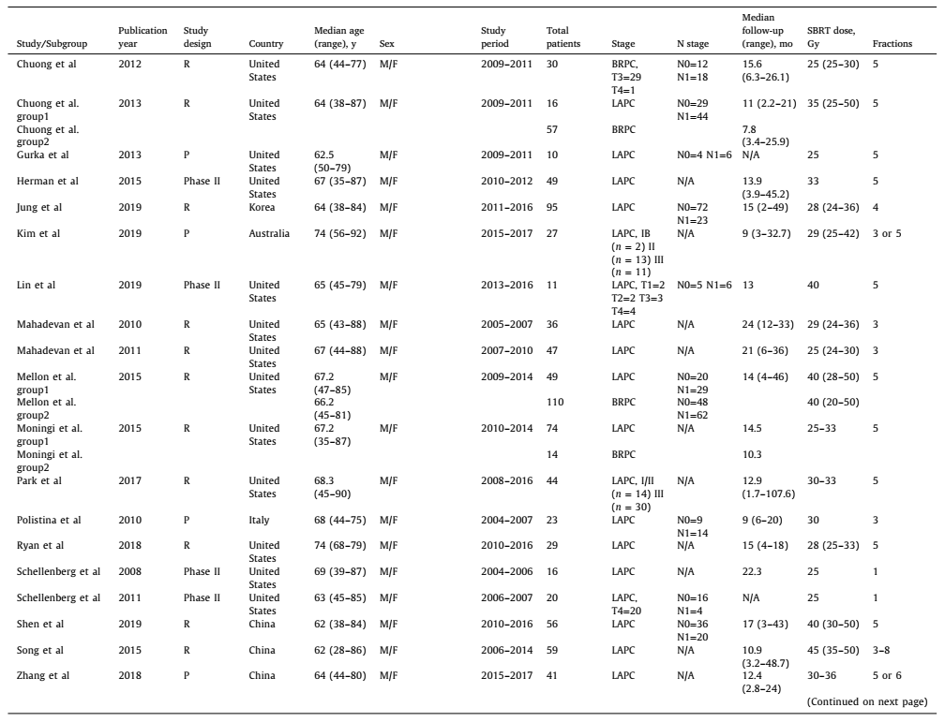
Study characteristics

Slide 21
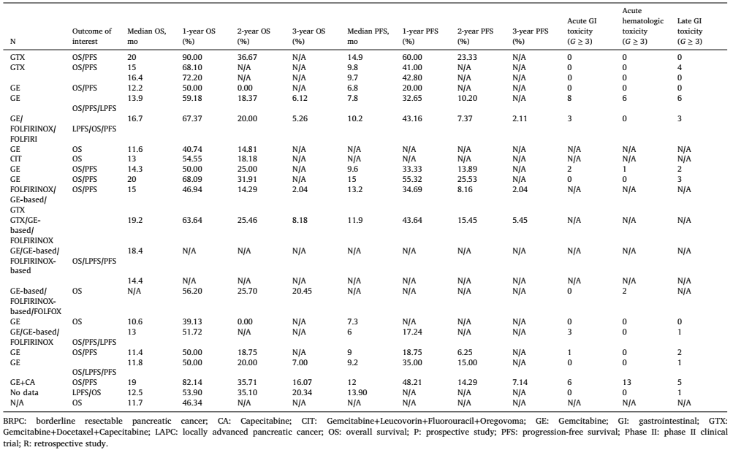
Study characteristics

Slide 22
Study characteristics
These included studies involving 800 patients published from 2010 to 2019;
Fifteen studies based on LAPC patients, 1 based on BRPC patients and 3 based on both;
In these studies, 8 were prospective studies, including 4 phase II clinical,and 11 were retrospective series.

Slide 23
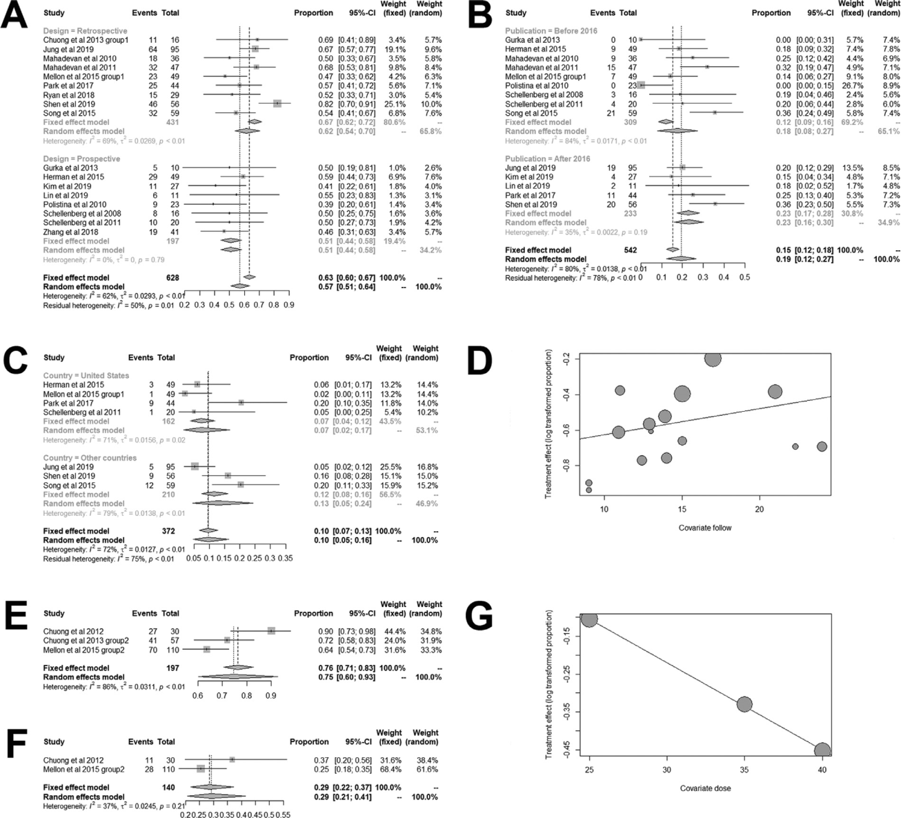
Pooled analysis of OS

Slide 24
Pooled analysis of OS
For the LAPC series, the median OS (range: 10.6–20 months, median: 14.1 months)
Pooled OS rates for 1-year, 2-year and 3-year by a random effects model were 57%, 19% and 10%, respectively.

Slide 25
Pooled analysis of OS
For the BRPC series, the median OS (range: 14.4–20 months, median:
17.5 months);
Pooled OS rates for 1-year and 2-year by were 75% and 29 %.

Slide 26
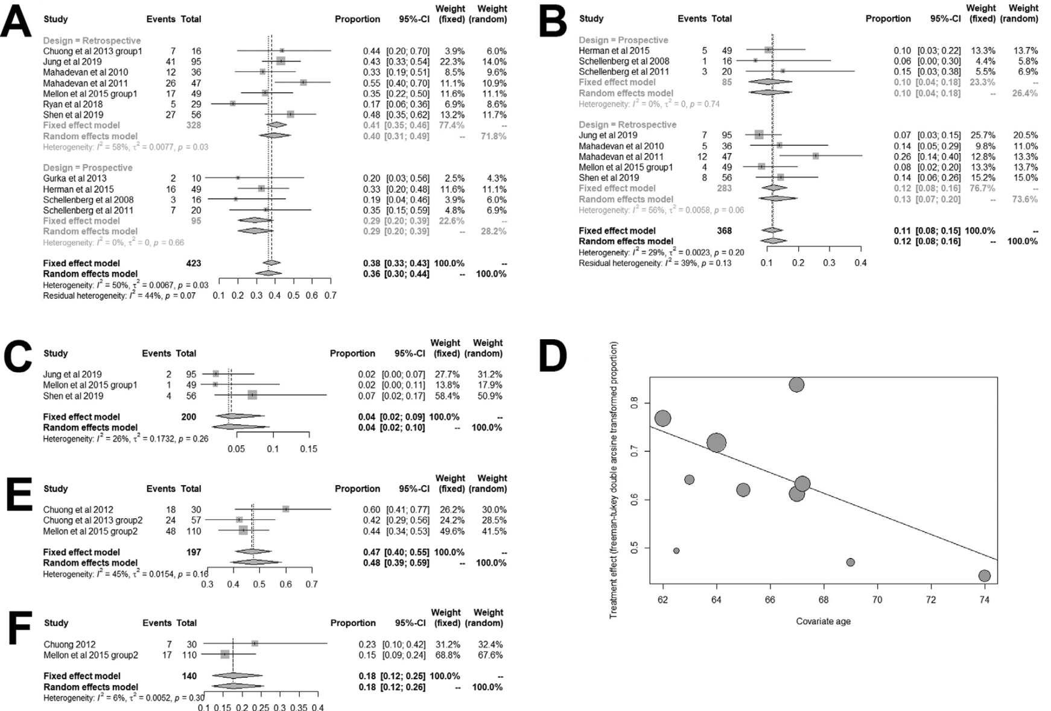
Pooled analysis of PFS

Slide 27
Pooled analysis of PFS
For the LAPC series, the median PFS (range: 6–15 months, median: 10 months)
Pooled PFS rates of 1-year, 2-year and 3-year were 36%, 12% and 4%, respectively.

Slide 28
Pooled analysis of PFS

Slide 29
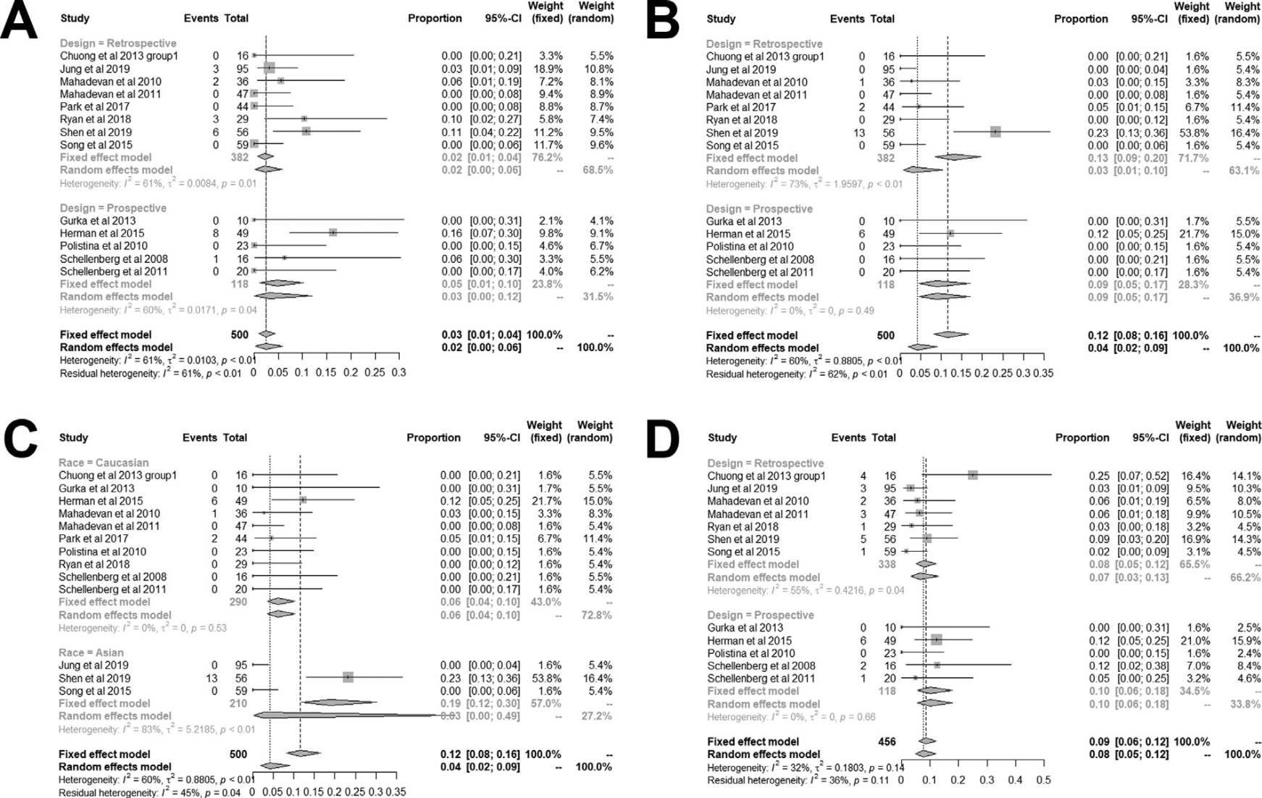
Toxicity

Slide 30
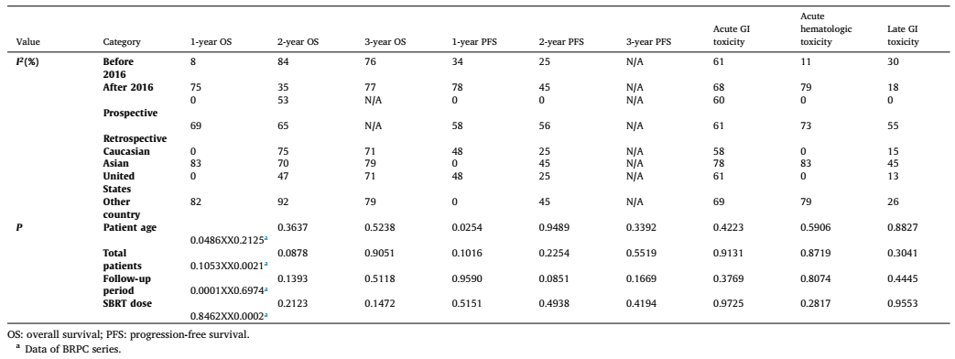
Heterogeneity analysis

Slide 31
Publication bias
For the LAPC series, the funnel plot and Egger’s test did not show any publication bias in pooled analysis of 1-year OS, 2-year OS , 1-year PFS , acute GI toxicity, acute hematologic toxicity and
late GI toxicity.
The Egger’s test and funnel plot were not conducted because limited studies were included in the other interest endpoint analyses.

Slide 32
Conclusion
SBRT并没有显示出比局部晚期胰腺癌和临界可切除胰腺癌的标准疗法更理想的治疗效果。
在进入III期临床试验之前，需要有更多的大型的OS超过24个月的II期RCT，因为目前这些研究大多是回顾性的或基于小型患者群体的单中心研究。

Slide 33

Thank You

