Slide 1

胰腺癌与维生素摄入之间的关系
刘适
齐齐哈尔医学院附属第三医院

Slide 2
Introduction
胰腺癌是恶性程度最高的癌症之一;
在中国，近80%的胰腺癌患者在初诊时已处于晚期，且近年来发病率不断上升;
因此，对胰腺癌的有效预防方法，如维生素的摄入，已引起全世界的关注。然而，回顾性的病例对照研究、队列研究、随机安慰剂对照试验和一些荟萃分析对维生素摄入与胰腺癌风险的关系有不同的结果;
因此，我们旨在通过荟萃分析研究维生素摄入量与胰腺癌风险之间的关系。

Slide 3
Search strategy
EMBASE, MEDLINE, and Cochrane
(pancreas OR pancreatic) AND (cancer OR carcinoma OR neoplasm) AND (vitamin OR food OR diet OR nutrition)

Slide 4
Study selection
Case–control, placebo–control, or cohort design;
Vitamin intake as the independent variable of interest；
PC as the dependent variable of interest plus reported PC incidence; and reported OR, RR, or HR, with 95% (CI);
Nonhuman studies, mechanistic research, and review articles were excluded.

Slide 5
Data extraction
First author’s last name;
Year of publication;
Study design;
Geographic location;
The age and sex of participants;
Follow-up period;

Slide 6
Data extraction
The size of study;
Type and doses of vitamins;
RR or OR with 95% CI for vitamin intake, and PC risk.

Slide 7
Quality assessment
NOS (Newcastle–Ottawa Scale);
Selection of cohorts (0–4 points);
Comparability of cohorts (0–2 points);
Exposure/outcome of the participant (0–3 points);
7 to 9 points were marked as “high quality.”

Slide 8
Statistical analysis
The random-effect model was used to combine RRs or ORs with 95% CI;
I² values of 25%, 50%, and 75% were considered low, moderate, and high heterogeneity, respectively;
A fixed-effect model was utilized if I² values <50%, otherwise a random-effect model was selected.

Slide 9
Statistical analysis
Meta-regression of the variables of study design, vitamin dose, and geographic area of study was employed to assess heterogeneity among all included studies;
The influence of grouping on total results was evaluated by subgroup stratification analysis.

Slide 10
Statistical analysis
Potential causes of heterogeneity were
estimatedbythe sensitivity analysis;
Publication biaswas evaluated by means of funnel plots and Egger test;
This meta-analysis was carried out with Rev Man 5.3 or Stata 12.1, and P<0.05 was considered statistically significant.

Slide 11
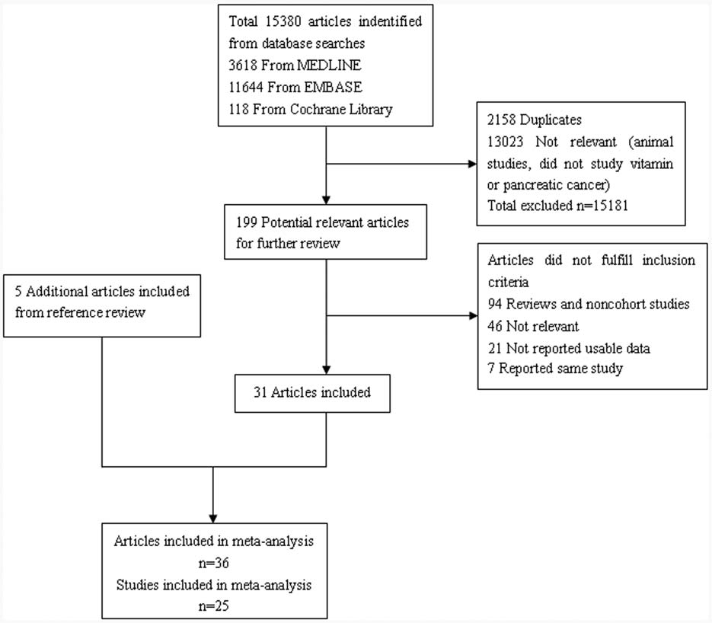
Search results

Slide 12
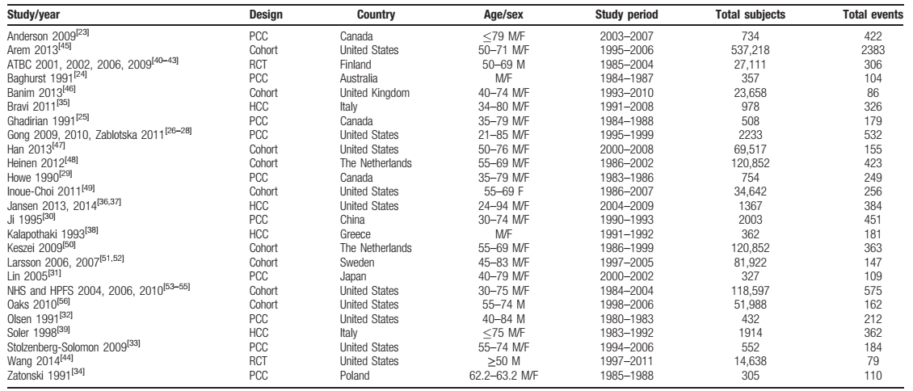
Study characteristics

Slide 13
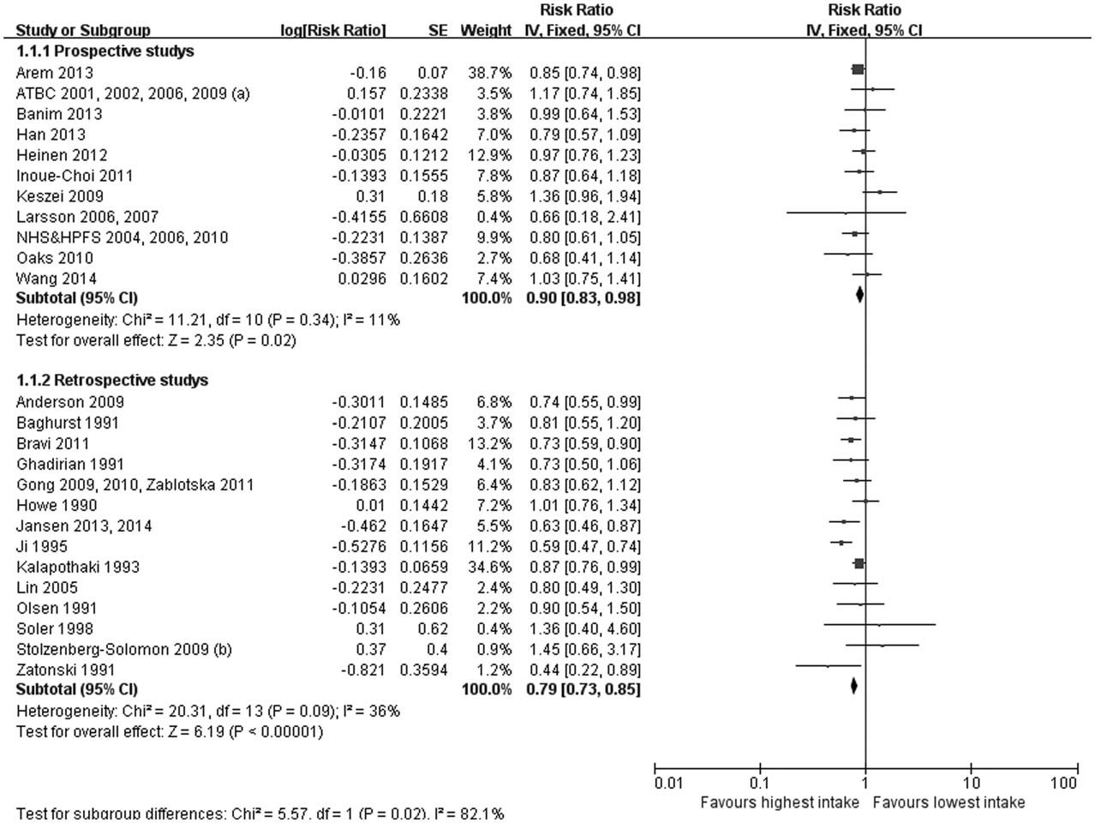
Vitamin intake and pancreatic cancer risk

Slide 14
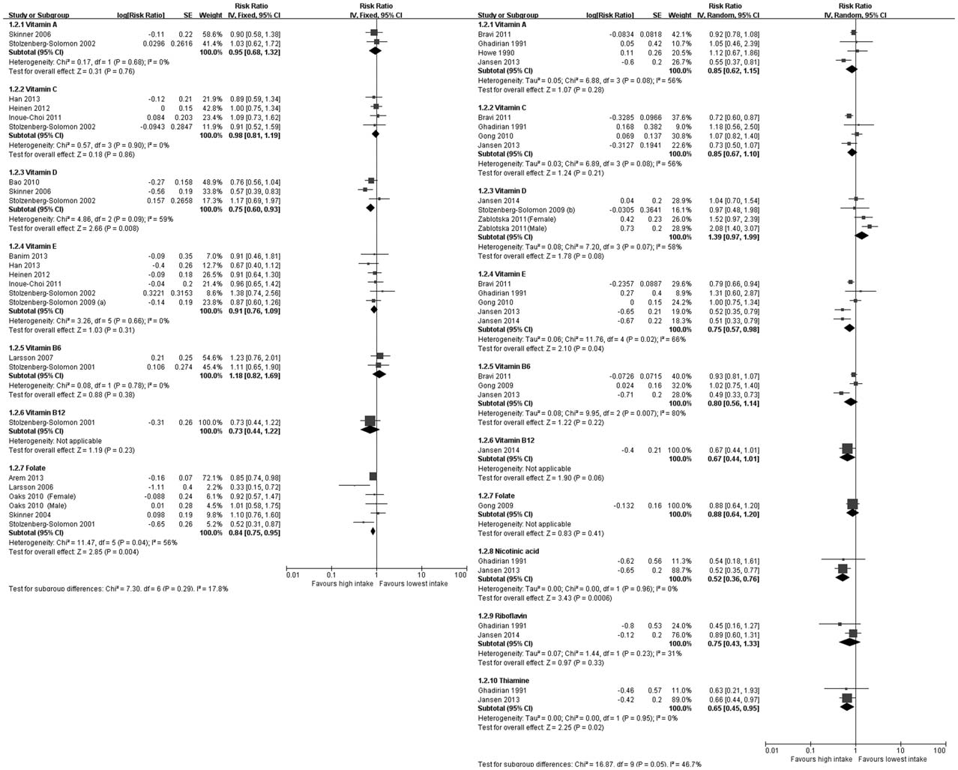
Dose–response meta-analysis

Slide 15
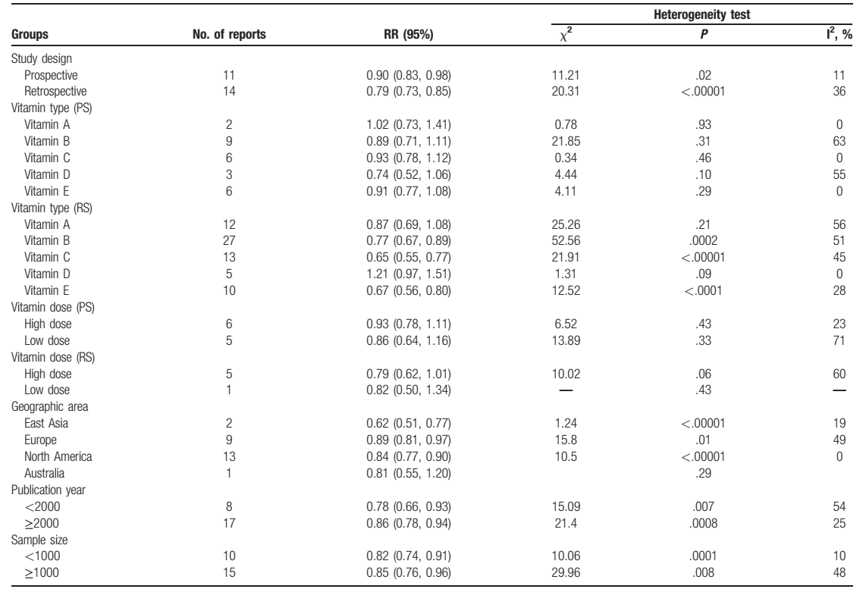
Subgroup analysis

Slide 16
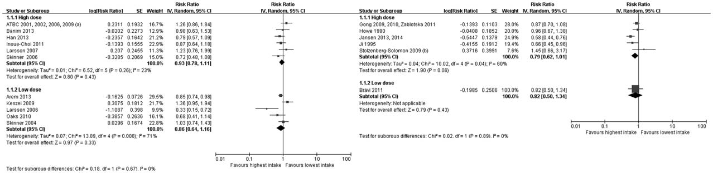
Subgroup analysis

Slide 17
Sensitivity analyses and meta-regression
After any single study was excluded, which did not affect the combined RRs.
Meta-regression analysis demonstrated that study design included significant sources of heterogeneity.

Slide 18
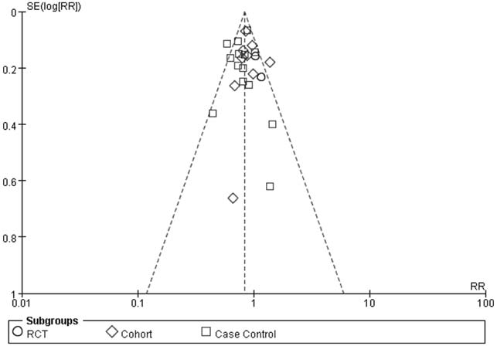
Publication bias

Slide 19
Conclusion
Vitamin intake can moderately reduce the risk of PC, particularly the consumption of vitamin D and vitamin B12.

Slide 20

Thank You

