Slide 1

EGCG治疗肿瘤的基础研究
刘适
齐齐哈尔医学院附属第三医院

Slide 2
Introduction
The major biologically components present in green tea are as catechins that account for 25–35% on dry weight.
This catechin group comprises eight constituents.
epigallocatechin gallate (EGCG)表没食子儿茶素没食子酸酯, which represents 50% to 80% of all catechins (200–300 mg/brewed cup of green tea)

Slide 3
Introduction
Among all of the tea types, EGCG is found at maximum comncentration in green tea leaves.
Pure EGCG is an odourless crystal and/or powder in white, pink, or cream colour.
It is soluble in water as a colorless and clear solution , It is also soluble in甲醇、乙醇、丙酮、吡啶和四氢呋喃.
EGCG have a melting point at 218 ◦C

Slide 4
Introduction
EGCG is poorly stable in water and poorly soluble in oils and fats. This poor stability and solubility restricts its direct addition in food products. Numerous delivery systems are, in practice, to preserve its structural integrity and shield EGCG from degradation
Numerous physical aspects like pH, light, oxidants contents, oxygen, temperature, and concentration of EGCG, influence the stability of EGCG

Slide 5
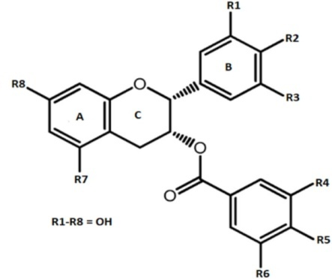
Chemical structure of EGCG

Slide 6
Occurrence of EGCG in different foods
A cup of green tea prepared by adding 2500 mg leaves in 0.2 L of water contains 90 mg of EGCG

Slide 7
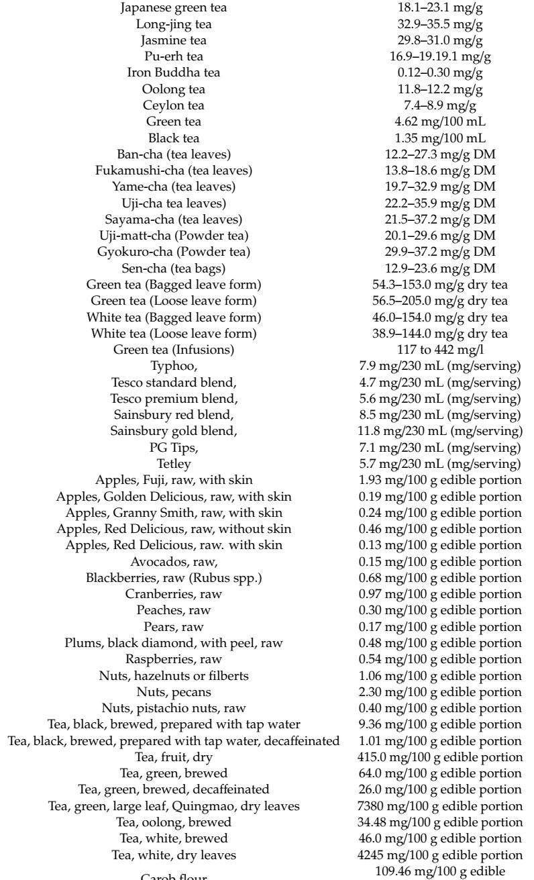

Slide 8
Signaling Pathways Involving EGCG: Proliferation, Differentiation, Apoptosis, Inflammation, Angiogenesis and Metastasis

Slide 9
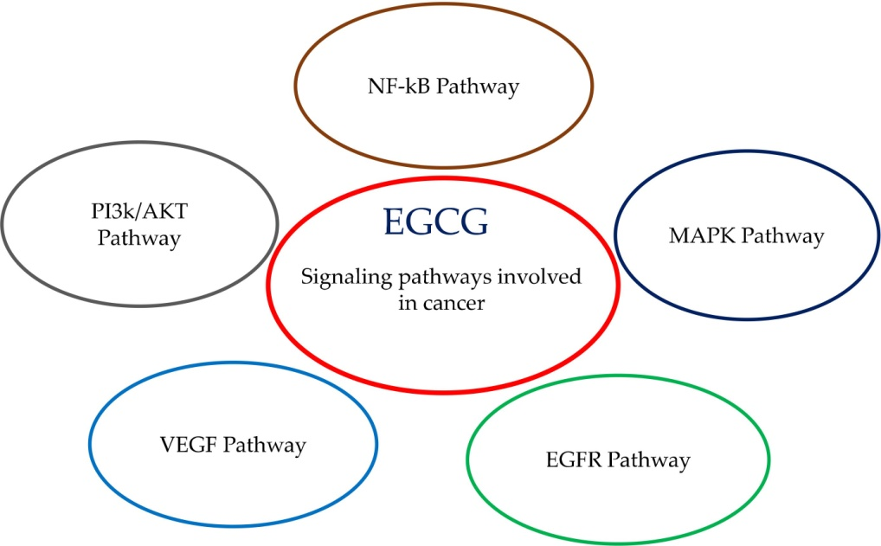
EGCG involved in the signaling pathways in cancer

Slide 10
Cell Death Induction
Cell death (Apoptosis, Necrosis, Autophagy)
EGCG induced apoptosis of human liver hepatocellular carcinoma HepG2 cells by decreasing the Bcl-2 protein and up-regulating Bax. The proposed mechanism of action of EGCG was related to Human antigen R (HuR, also known as ELAVL1), which can control amyloid protein precursor淀粉样蛋白前体(APP) via HuR-Erk1/2-APP pathway.

Slide 11
Cell Death Induction
EGCG reduced proliferation while promoting apoptosis in tongue squamous cell carcinoma CAL27 and SCC 15 cells via the Hippo-TAZ signaling pathway
EGCG induced apoptosis in a dose-dependent manner in human thyroid carcinoma cell lines by increasing the Bax/Bcl-2 ratio, thus pointing to an increase of 线粒体-mediated apoptosis and the involvement of EGFR/RAS/RAF/MEK/ERK signaling pathway

Slide 12
Cell Death Induction
In hepatocellular carcinoma cells, EGCG induced autophagy via direct interaction with LC3-I protein and, consequently, led to the degradation of α-fetal protein (AFP);
EGCG has been also proposed as protective agent against necrosis induction because of its demonstrated action on reduction of oxidative stress and inflammatory responses

Slide 13
Cell Cycle Arrest
EGCG inhibited the proliferation of liver cancer cells in G2 phase and induced apoptosis after the blocking of the cell cycle progression in the G1 phase.
EGCG increased the expression of CDK1（周期蛋白依赖性激酶cyclin-dependent kinases） proteins and inhibited the expression of Cyclin D1 and the phosphorylation of retinoblastoma视网膜母细胞瘤 proteins.

Slide 14
Cell Cycle Arrest
EGCG treatment has been associated to cell cycle arrest affecting upregulation/downregulation balance in which p1/p21, Kip1/p27, p16/INK4A, cyclin D1, cyclin E, CDK2, and CDK4 proteins are involved. This effect was demonstrated to be the first step of the apoptosis cascade induction via ROS and subsequent caspase-3含半胱氨酸的天冬氨酸蛋白水解酶 and caspase-9 action.

Slide 15
Cell Cycle Arrest
EGCG treatment of melanoma 黑色素瘤cells results in the modulation of cyclin-dependent kinases inhibitor network and Bcl2 family proteins with a consequent inhibition of viability and growth, cell cycle blocking, and apoptosis induction

Slide 16
  COX-2
Cyclooxygenase-2环氧化酶(COX-2) is involved in the modulation of different cell processes, such as oxidative stress and inflammation.
Dysregulated activity of COX-2 were described in many cancers.
EGCG was demonstrated to inhibit COX-2 both in terms of transcription and translation in human prostate carcinoma cells (LNCaP and PC-3)

Slide 17
  COX-2
a significant decrease of COX-2 activity in the cells of the colon of rats treated with EGCG pointing to a prevention in the formation of preneoplastic foci
the inhibitor mechanism of COX-2 by EGCG was described as the cascade effect of EGCG inhibition of the catalytic 催化activity of ERK and p38 MAPK that are the upstream enzymes that regulate COX-2 expression

Slide 18
EGFR Pathway
The dysregulation of EGFR expression has been associated with cellular neoplastic transformation.
EGCG inhibited EGFR and HER2 in colon cancer cells (HT29), resulted in cell growth reduction, cell cycle arrest in G1 phase, and apotosis induction by the activation of caspase-3 and -9, with critical impact on EGFR/ERK and EGFR/Akt signaling pathways

Slide 19
MAPK Pathway
The MAPK pathway is a key signaling pathway frequently dysregulated in human cancer and can control multiple cell functions, such as proliferation and growth
EGCG could modulate inflammation biomarkers, reduce cell proliferation, and induce apoptosis through the decrease of MAPK signaling in a prostate cancer mouse model （TRAMP mice）.

Slide 20
MAPK Pathway
EGCG inhibited cell growth and induced apoptosis through the inhibition of Bcr/Abl oncoprotein and regulation of its downstream signals, such as p38-MAPK and JNK in chronic leukaemia cells
EGCG activated caspase-3 and -9, cytochrome 细胞色素c, mitochondria线粒体, c-Jun, and MAPK pathway, with the end result of apoptosis induction in a human colon cancer cell (HT-29)

Slide 21
MAPK Pathway
EGCG induced the phosphorylation of p38, which mediated the phosphorylation of EGFR at Ser1046/1047, leading to a downregulation of the EGFR/MAPK pathway in colon cancer cell (SW480)
in HCT116 colorectal carcinoma cells, EGCG triggered the phosphorylation of ERK, JNK, and p38, which conducted to apoptosis

Slide 22
MAPK Pathway
EGCG was found to suppress cell proliferation by upregulating BTG2 (B-cell translocation gene 2) expression via MAPK pathway in oral squamous cell carcinoma (OSCC), in particular with the phosphorylation of p38, JNK, and ERK

Slide 23
MAPK Pathway
In thyroid cell carcinoma (ARO cells), EGCG showed anti-proliferative and pro-apoptotic effects, being mediated by the suppression of phosphorylated EGFR, ERK1/2, JNK, and p38 and p21, caspase-3, and cleaved PARP increase and cyclin B1/CDK1 expression decline

Slide 24
MAPK Pathway
human hepatoma HepG2-C8 cells and human cervical squamous carcinoma HeLa cells were used to evaluate EGCG . The results indicated that catechin induced the activation of ERK, JNK, and p38 in a dose- and time-dependent manner, with stimulation of apoptosis (mediated by caspase-3)

Slide 25
MAPK Pathway
human prostate cancer androgen-unresponsive and responsive cells (DU145 and LNCaP, respectively) that were treated with EGCG showed an increase of ERK1/2 with concomitant decrease of phosphorylated AKT and the level of PI3K

Slide 26
  NF-kB Pathway
NF-κB (Nuclear factor-κB) is involved in a variety of cellular mechanisms, such as death, growth, inflammation, and immune response.
NF-κB mainly acts as a regulator of gene transcription in response to oxidative stress.

Slide 27
  NF-kB Pathway
EGCG was able to activate caspases in epidermoid 表皮细胞carcinoma cells, and this has been demonstrated to play a relevant role in the inhibition of NF-κB and induction of apoptosis
EGCG has been demonstrated to play a potential role in human colon cancer prevention inhibiting AP-1, c-fos, cyclin D1 promoters, and NF-κB activity in four different human colon cancer cell lines

Slide 28
PI3k/AKT Pathway
EGCG modulation on the PI3K/AKT signaling pathway was associated to lung cancer prevention and suppression.
EGCG activation/inhibition of PI3K/AKT was found to be a key switch in lung cancer H1299 cells growth inhibition and apoptosis induction

Slide 29
  VEGF Pathway
Given its involvement in metastasis and growth of tumor cells, vascular endothelial growth factor (VEGF） possesses a key player in angiogenesis
In human gastric cancer SGC7901 cells EGCG reduced expressions of HIF-1α and VEGF with a concentration-dependent effect.

Slide 30
  VEGF Pathway
In addition, in SGC-7901 mouse xenografts, 1.5 mg/day EGCG intraperitoneally injected reduced VEGF, tumor microvessel density, endothelial cell proliferation, migration, and tube formation, substantially blocking tumor growth

Slide 31
  VEGF Pathway
In gastric cancer 5-FU resistant cells, EGCG inhibited VEGF and HIF-1 expression, reversing 5-FU resistance that is mediated by VEGF pathway
In human gastric cancer cells (AGS) EGCG reduced dose-dependently VEGF expression and secretion mediated by signal transducer and activator of transcription 3 (Stat3)转录信号传导激活子 activity

Slide 32
  VEGF Pathway
In colon cancer cells (Caco2, HCT116, HT29, SW480, and SW837 lines) and SW837 mouse xenograft, EGCG impacted on VEGF/VEGFR axis suppressing VEGFR2 (a primary responder to VEGF signal), together with HIF-1α, ERK, and AKT

Slide 33
  VEGF Pathway
In human colon cancer cell line (HT29) and derived mouse xenografts, EGCG lessened VEGF expression and its promoter activity, while decreasing the tumour growth and microvessel density in mice (treated daily intraperitoneally with 1.5 mg EGCG), and modulating cell proliferation and apoptosis in HT29 cells

Slide 34
  VEGF Pathway
In breast cancer cells (MCF-7), HIF-1α and VEGF was decreased by EGCG in a dose-dependent manner (25, 50, 100 mg/L)
In head and neck squamous cell carcinoma (YCU-H891) and breast carcinoma cell lines (MDA-MB-231), EGCG blocked VEGF activity, thanks to the inhibition of activation of Stat3 and NF-κB

Slide 35
  VEGF Pathway
In B-cell chronic lymphocytic leukemia (B-CLL), EGCG 3–25 µM reduced VEGF-R1 and VEGF-R2 phosphorylation (fundamental in B-CLL survival and growth) and induced apoptosis by caspase-3 activation, poly-adenosine diphosphate ribose polymerase多聚腺苷二磷酸核糖聚合酶(PARP) cleavage, and B-cell leukemia/lymphoma-2 protein (Bcl-2)

Slide 36
  Proteasome
The proteasome蛋白酶体 is a protein complex that is dedicated to degrade damaged or useless proteins that are unusable to cell
EGCG specifically blocked proteasome activity in LNCaP, PC-3, and MCF-7乳腺癌 cell.

Slide 37
  Proteasome
EGCG in breast carcinoma cell line (MDA-MB-231) and in MDA-MB-231 mouse xenografts (daily sub cute injection with 50 mg/kg) was tested, showing tumor growth decrement, with concomitant proteasome inhibition and apoptosis activation

Slide 38
  Epigenetics
Epigenetics refers to heritable phenotype changes, in which DNA sequence alteration are not included. The most known epigenetic mechanisms involve DNA methylation and histone组蛋白 modification

Slide 39
  Epigenetics
EGCG could block DMNT and reactivate methylated-silenced genes, as p16(INK4a), retinoic acid receptor视黄酸受体β (RARβ), O-(6)-methylguanine methyltransferase甲基鸟嘌呤甲基转移酶(MGMT), and human mutL homologue 1 (hMLH1) in human esophageal cancer cells (KYSE 510), colon cancer HT-29, and prostate cancer PC3 cells.

Slide 40
  Epigenetics
Similar results were obtained in human breast cancer cell lines (MCF-7 and MDA-MB-231), whereas EGCG was able to block prokaryotic原核生物 SssI DNA methyltransferase (DNMT) and human DNMT1

Slide 41
  Epigenetics
EGCG acted on inhibitor of matrix metalloproteinases (TIMPs) and MMPs, being highly involved in tumorigenesis, in human prostate cancer cells (DUPRO and LNCaP)
EGCG restored TIMP-3 expression and concomitantly increased histone H3K9/18 acetylation and decreased class I histone deacetylase, impacting on cell invasion and migration.

Slide 42
  Epigenetics
Interestingly in serum of patients undergoing prostatectomy consuming 800 mg EGCG up to 6 weeks (participating to clinical trial NCT01340599), TIMP-3 levels were increased, suggesting a potential mechanism of action of EGCG in prostate cancer . However, the trial failed to show a significant benefit of EGCG-treated prostate cancer patients

Slide 43
  Epigenetics
In a SKH-1 hairless mouse model, EGCG added to a hydrophilic 亲水cream and applied to approximately 1 mg/cm2 skin area could protect against photocarcinogenesis through the reduction of tumor incidence, tumor multiplicity, and tumor size. Mechanisms at the basis of these results are related to the inhibition of DNA hypomethylation induced by ultraviolet B treatment.

Slide 44
  Epigenetics
In human skin cancer cells (A431) and squamous cell carcinoma (SCC 13) cells, EGCG could reactivate p16INK4a and Cip1/p21, impacting not only on DNA methylation and DNMT activity, but also on histone deacetylase脱乙酰酶(HDAC) activity and acetylated乙酰化 histones

Slide 45
  Epigenetics
It has been shown in a salivary adenoid cystic carcinoma cells (SACC83) that the catechin was able to demethylate 去甲基化 RACK gene and thus impact on invasion, migration, and metastasis.
In a mouse lung tumor model, EGCG was implicated in DMNT1 reduction with simultaneous decrease of p-AKT, phospho-histone磷脂酰组蛋白H2AX and tumor growth

Slide 46
MicroRNA
MicroRNA (miRNA) is a small non-coding RNA molecule can post-transcriptionally regulate gene expression.
miRNAs are involved in numerous cell processes, including growth, proliferation, apoptosis, autophagy, metabolism, etc., and play a fundamental part in cancer.

Slide 47
MicroRNA
In prostate cancer cells (PC3) and PC3 mouse xenografts, EGCG blocked nuclear translocation and protein expression of androgen receptor, and these effects were associated with the down-regulation of androgen-regulated miRNA-21 and up-regulation of miRNA-330, a tumor suppressor

Slide 48
MicroRNA
Another target of EGCG was miRNA-210, being upregulated by the catechin in lung cancer cell lines (CL13, H1299, H460, A549), with induced accumulation of HIF-1α, which is a known miRNA-210 activator
EGCG in a dose- and time-dependent manner inhibited the proliferation and regulated expression of miR-210, miR-29a, miR-203, and miR-125b in human cervical cancer cell lines (HeLa, SiHa, CaSki and C33A )

Slide 49
Other Mechanisms
The anticancer properties of EGCG may be dependent on the inhibition of the protease urokinase-plasminogen activator蛋白酶尿激酶-凝血酶原激活剂 (uPA), which is often overexpressed in human tumors and whose activity is involved in the regulation of apoptosis, cell replication, migration, and adhesion

Slide 50
Conclusion
EGCG is responsible for a wide variety of biological activities, including cancer prevention.
The preclinical activities of EGCG are associated with proliferation, differentiation, apoptosis, inflammation, angiogenesis, and metastasis.
More efforts are needed to translate the preclinical data in effective human therapeutic options.

Slide 51
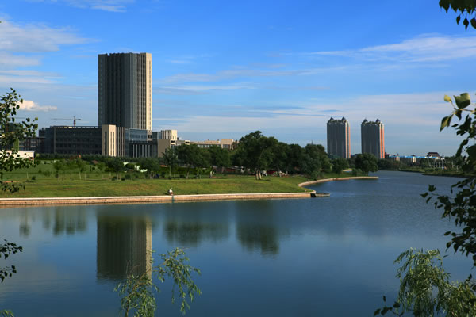
Thank You

